Slide 1

Mathematics Department
Youth STEM Journal Club
Veer Mahajan

Slide 2
About me
Discussion on math competitions!
Middle school is a good time to start
MATHCOUNTS
AMC 8
MOEMS
Many more!
Rising junior
Got interested in math in elementary school
Math competitions for several years
Higher-level math courses at community college
Some qualifications
Rigorous courses inside and outside of school (A/A+ grades in Calculus 1, Calculus 2, and Differential Equations outside of school, straight As within school courses
Won MOEMS competition in middle school
AIME qualifier

Slide 3
What is mathematical research all about?
Mathematical research has effects all around us, but generally tends to be highly abstract.
To make this more suitable, we will consider:
General mathematical writing and practices relating thereto
Tangible results from research papers
Applications of mathematical foundational principles
Modeling networks
Cryptography and cybersecurity
Connections with other fields

Slide 4
How will we teach mathematical research?
In our meetings, we’ll have interactive discussions and activities.
Online workshops are to hone general research skills and understand key concepts
Our meetings are to understand our research and how mathematics is studied and used in the real world
Core ideas from linear algebra and calculus will be introduced to help facilitate understanding
Online resources (Google Classroom) can be used for
Asking questions to other students and myself
Contributing to discussions
Viewing materials asynchronously

Slide 5
Topics of study
We’ll focus on two main articles this summer.
Between these two, we will uncover:
Best practices in mathematical writing/how to get used to reading and understanding complicated math
More resources in Google Classroom
The structure of a research paper and how to read/study research papers
Ideas within number theory, calculus, and linear algebra (mainly matrices)
Applications of mathematics to various disciplines

Slide 6
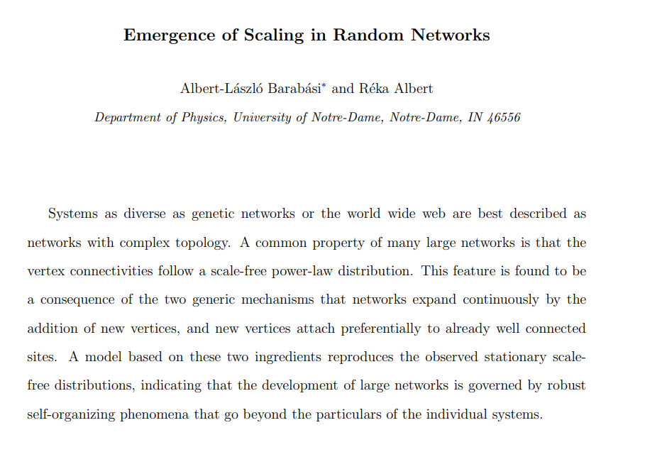
Topics of study
This focuses on modeling large systems like the world wide web with complex topology, making use of properties of random networks previously not considered.
We’ll spend about 4 lectures reading and analyzing/discussing this paper.

Slide 7
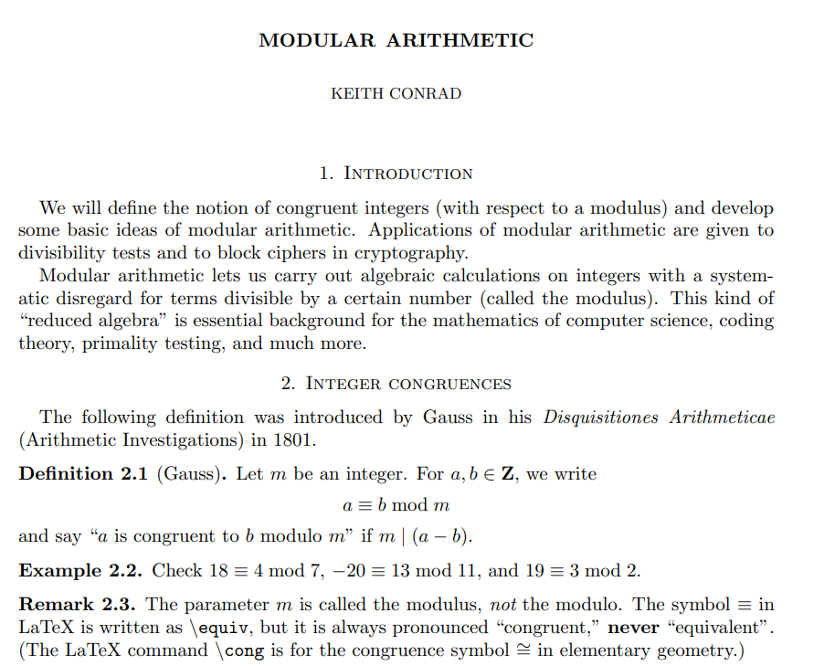
Topics of study
This is less of a research paper and more so an instructional/informational piece on already established mathematical principles, but is a good example of how mathematical literature is presented. It also includes various applications to cryptography and cybersecurity.
We’ll spend 1-2 weeks here.

Slide 8
Activities
YSJC math is meant to be fun and educational, not boring! Thus,
Most of the class is NOT lecture.
We’ll have many discussions and question-answer sessions, which will foster interaction between and creative thinking from students.
There will be a few activities like:
Caesar cipher challenges
Block cipher challenges (these are anticipated to take quite some time)
Demonstrations of distributions and models like the Poisson distribution using Desmos graphing software
These weeks will be engaging and enjoyable!

